Slide 1

Reimagining the OSM.org
by Gustavo Soares
https://github.com/Playzinho/gaia

Slide 2
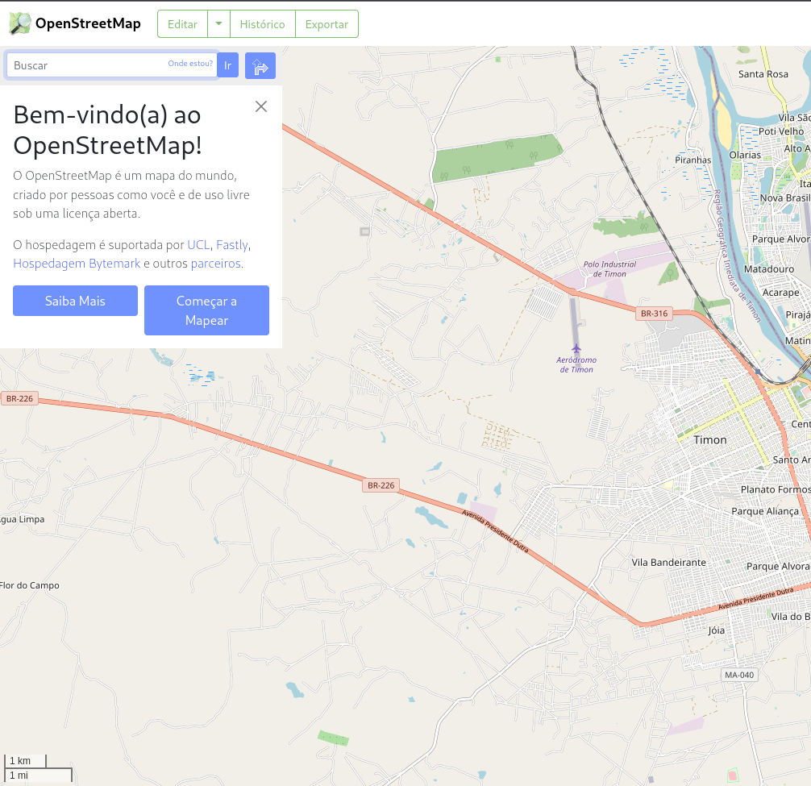
OSM.org Now
Is dated
inflexible design
Does not support group creation
It does not make it easy to meet new mappers or communities

Slide 3
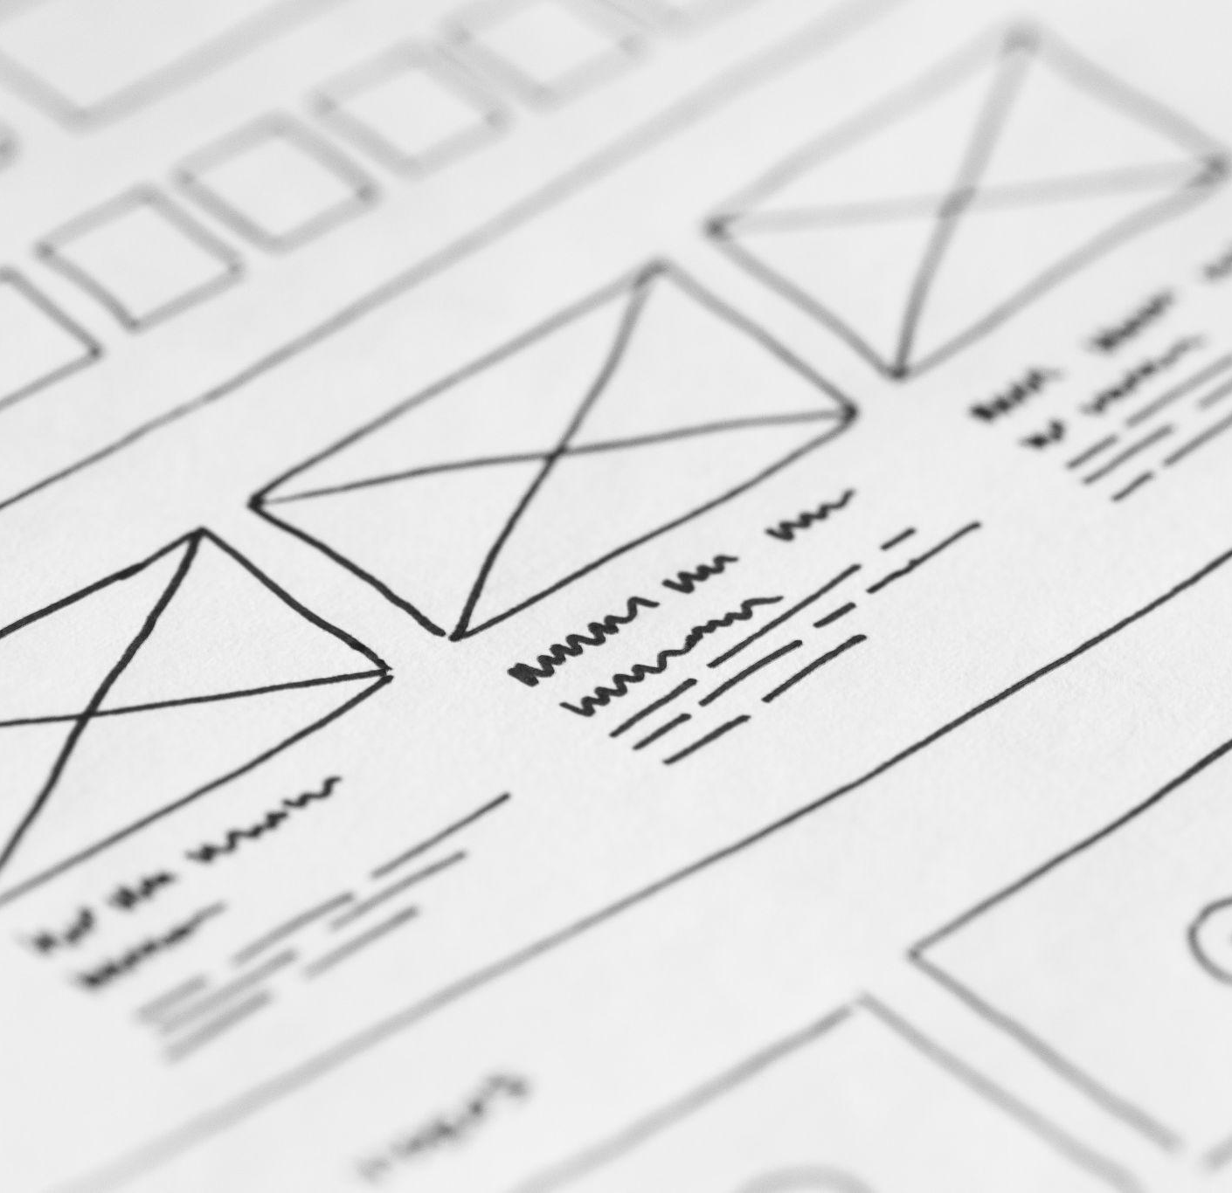
OSM.org is a problem Design

Slide 4
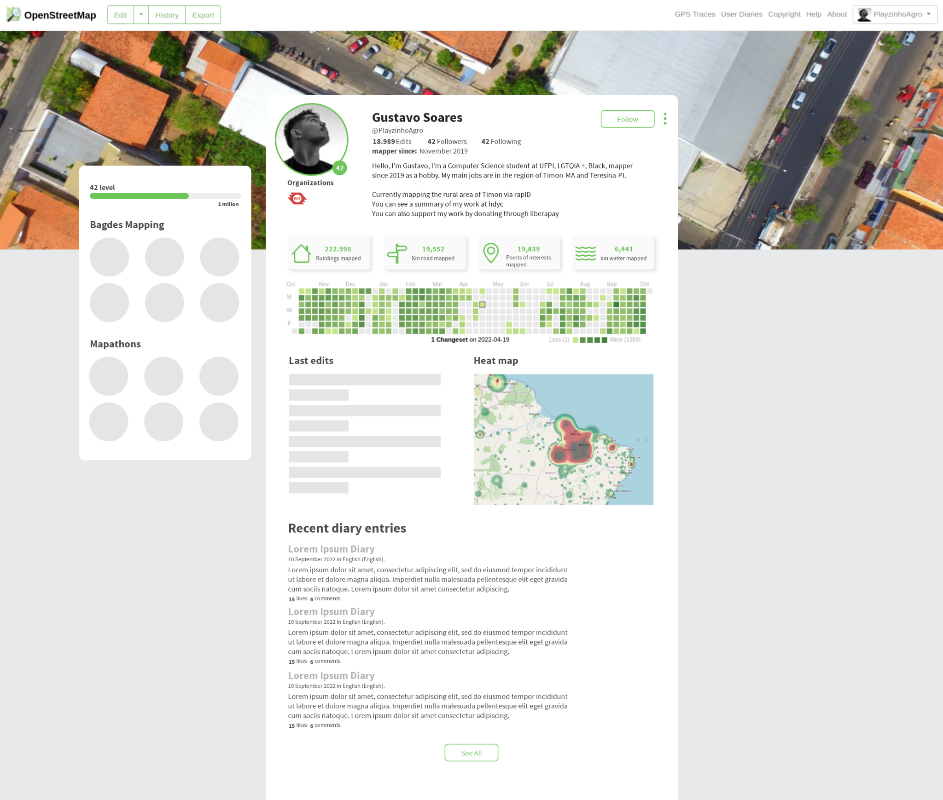
New user profile
User statistic
Customizable
Social
Gamification
Mordern

Slide 5
User statistics
No need to add an external link in your Bio now OSM.org shows your stats

Slide 6
User activity
A way to identify where the mapper is most active and its latest edits

Slide 7
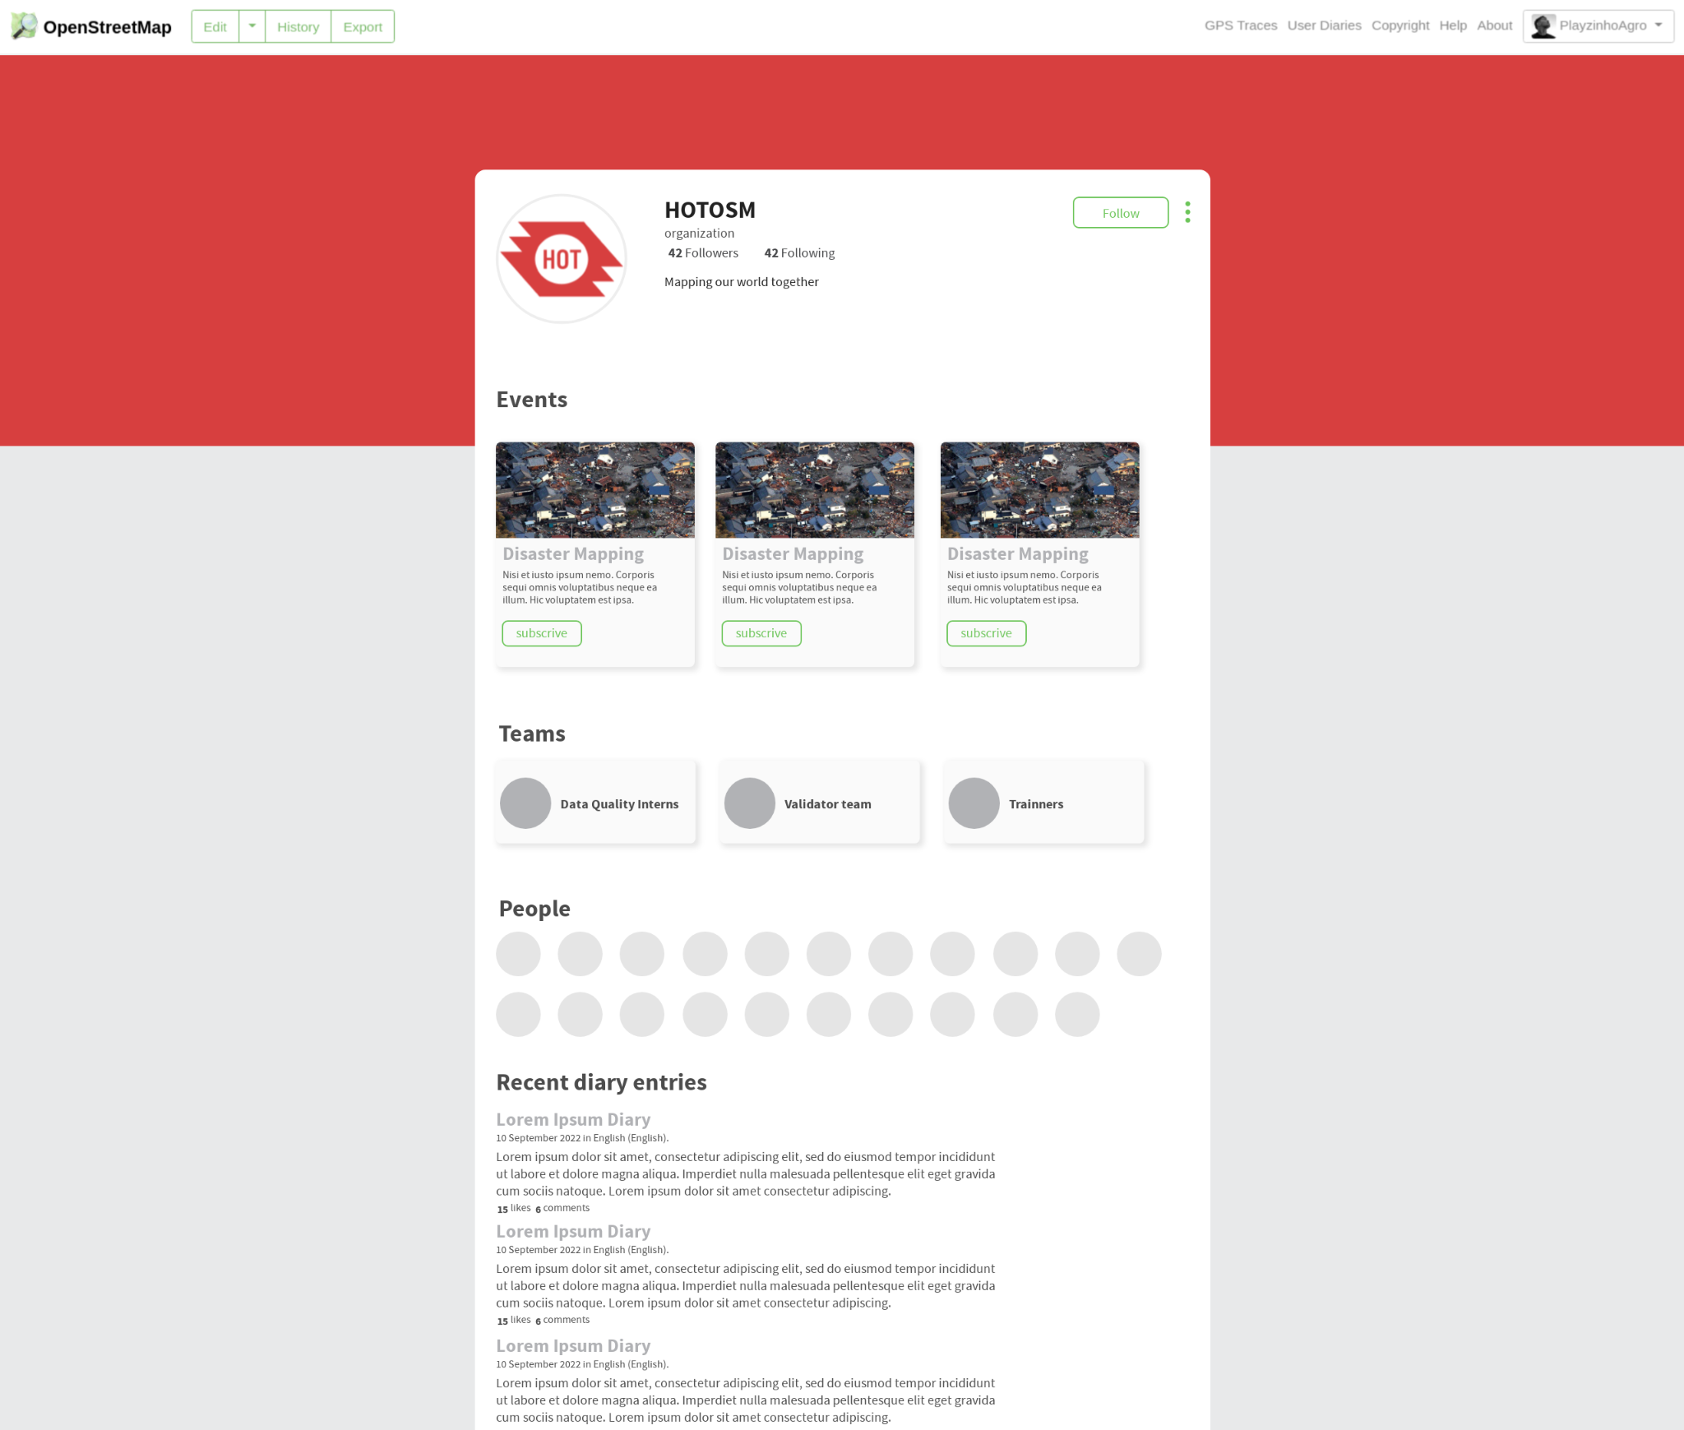
Introducing Organizations Profiles
Events
Teams
Who is involved
Diaries entries
Customizable

Slide 8
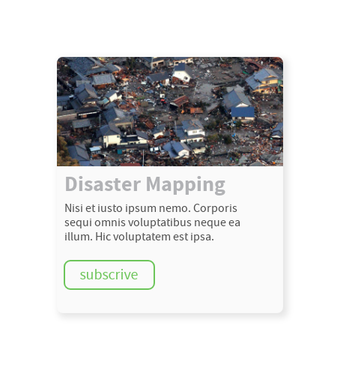
Events
Create mapping or training events directly from OSM.org

Slide 9
Teams
Organize your teams and who participates

Slide 10
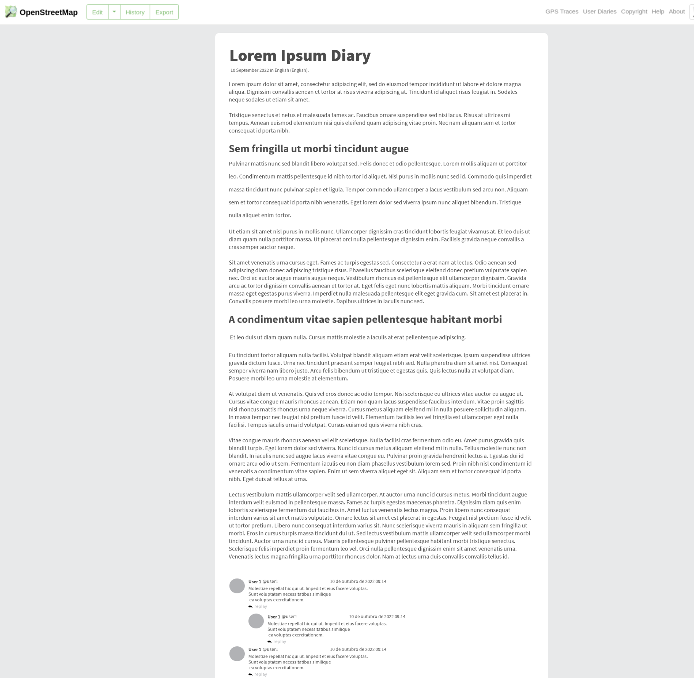
New Diary Layout
Events
Teams
Who is involved
Diaries entries
Customizable

Slide 11
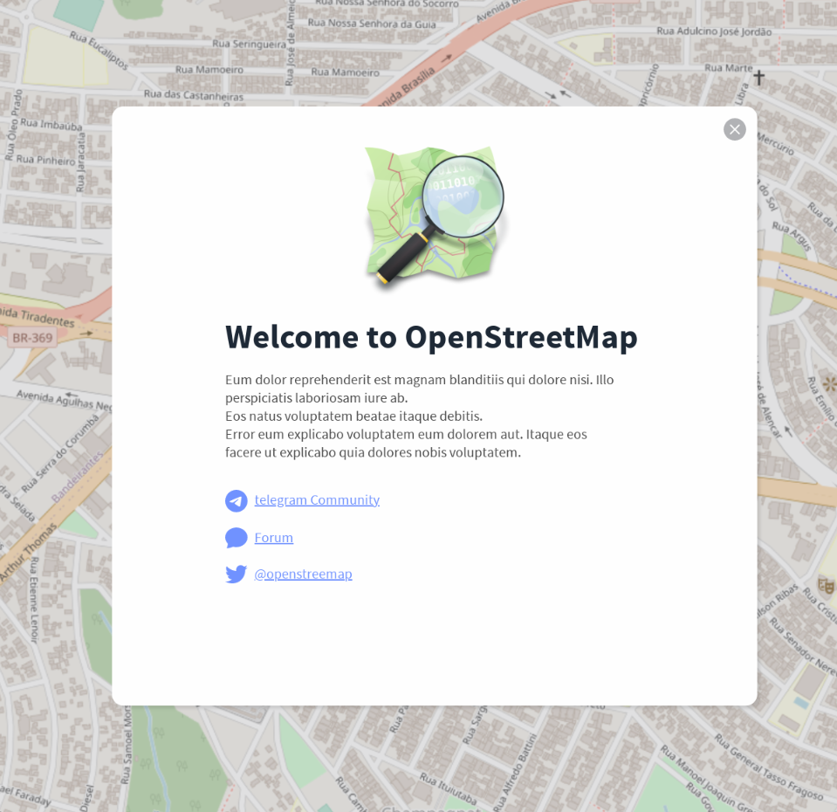
Welcome pop-up
User statistic
Customizable
Social
Gamification
Mordern

Slide 12
And more…
Project Page
New Login page
Integration
Gamification
New home page

